Slide 1
Android Services
Basit Ali

Slide 2
Android Services
A service is a component that runs in the background & foreground.
It can perform long-running operations in the background.
It does not provide a user interface.
Once started, a service might continue running for some time, even after the user switches to another application or activity.

Slide 3
Algorithm
Create a sample project.
Add two buttons – Start Service & End Service.
Create a new XYZservice class which extends Service class. .
Add service to manifest file.
Onclick(Start Service) - Start Service through intent.
Onclick(End Service) – End Service through intent.

Slide 4
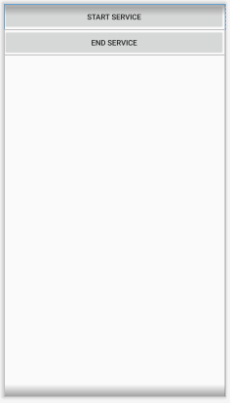
User Interface.

Slide 5


Create a PlayService java class
The class should extend Service class

Slide 6
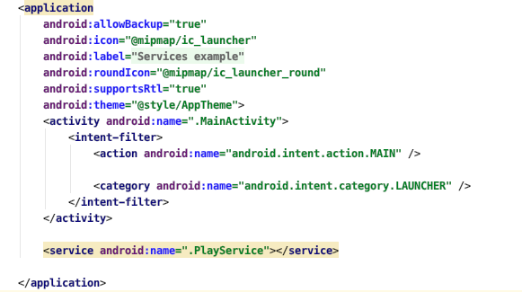
Add this line in manifest file.
Add the highlighted (Service) line in manifest file.

Slide 7
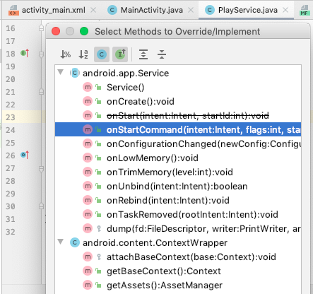
Add two methods in PlayService class
These two methods will be responsible for Starting and destroying service
Press cntrl + o to get the dropdown menu.

Slide 8

Add two methods in PlayService class
Add these two methods.

Slide 9
onStartCommand(...)
Write code which you want to execute when the service starts.
Ex:Play a song in background
Replace return statement with return START_STICKY;

Slide 10
OnDestroy(…)
Write code to stop the code running.

Slide 11
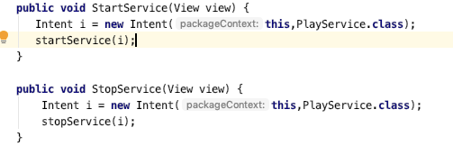
Starting & Stopping Service

